Slide 1
Havant Pastoral Area
Update February 2025
Welcome!

Slide 2
You Will Be My Witnesses Mission Plan
1) To be a Christ-centred Church putting Christ at the centre of our hearts and lives.
2) To be missionary communities going out on Christ’s service and mission.
3) To be prudent stewards of Christ’s Church making wise choices to leave a sustainable legacy for future generations

Slide 3
The most significant changes
One Parish is being formed out of our current 6 parishes.
At present there are 87 Parishes in our diocese. This will be reducing to 24 Parishes made up of several church communities.

Slide 4
The most significant changes
One Parish Priest will be working with a team of other priests, and all will be working to their particular strengths.

Slide 5
The most significant changes
Both clergy and Lay are keen that there will remain identifiable pastors for each respective church community.

Slide 6
The most significant changes
We are beginning to discern which activities are better to do together as one larger Parish, and which are preferable to continue to do as individual communities

Slide 7
The most significant changes
We are drawing on a bigger pool of lay & clerical expertise and experience.

Slide 8
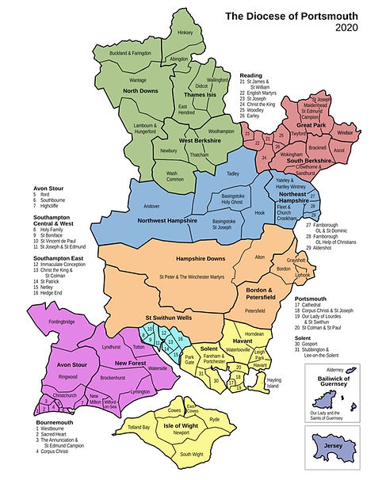



Havant Pastoral Area
6 Parishes
8 Churches
7 Presbyteries
6 Clergy
1 Deacon
3 Primary Schools
1 Secondary School
1 Sixth Form College
2,487 Pupils
1 Large NHS Hospital Trust
1 Private Spire Hospital
1 Hospice

Slide 9

Havant Pastoral Area
New Parish G
Ten Year Plan
Pastoral Area Establishment and Local Discernment
July 2023

Slide 10
Outcome from this meeting
Commissioning of the 144 present to Fr Jeremy
1) Create a Pastoral Council of laity and clergy.
2) Communicate regularly with the Pastoral area what is going on.
3) Get on with it!

Slide 11
A good starting point!
Clergy meet and socialise together
Schools
Hospitals
Confirmation
Reconciliation Services
Pulpit Swops

Slide 12
Phase 1 - Havant Area Council Membership
 | Consolidation & Rationalisation | Discernment Process | Evangelisation Strategy | Finance & Estate Review
Clergy | Fr Jeremy Garratt (Council Chair) Deacon Nick O’Neill | Fr Joe Gruszkiewicz | Fr James Lewis Fr Mark Whiting | Fr Gerard Flynn
Laity | Matthew Hordell | Gabriel Semple Jim Hordell Declan Murphy | Jessica Heath Emma Mpario Josie Higson Damian Banka | Ian Hamill Seamus Higson Edyta Duchnowska
Chair Secretary | Alison McCann | Karena Fulford | Chris Bates | Vivienne McCabe

Slide 13
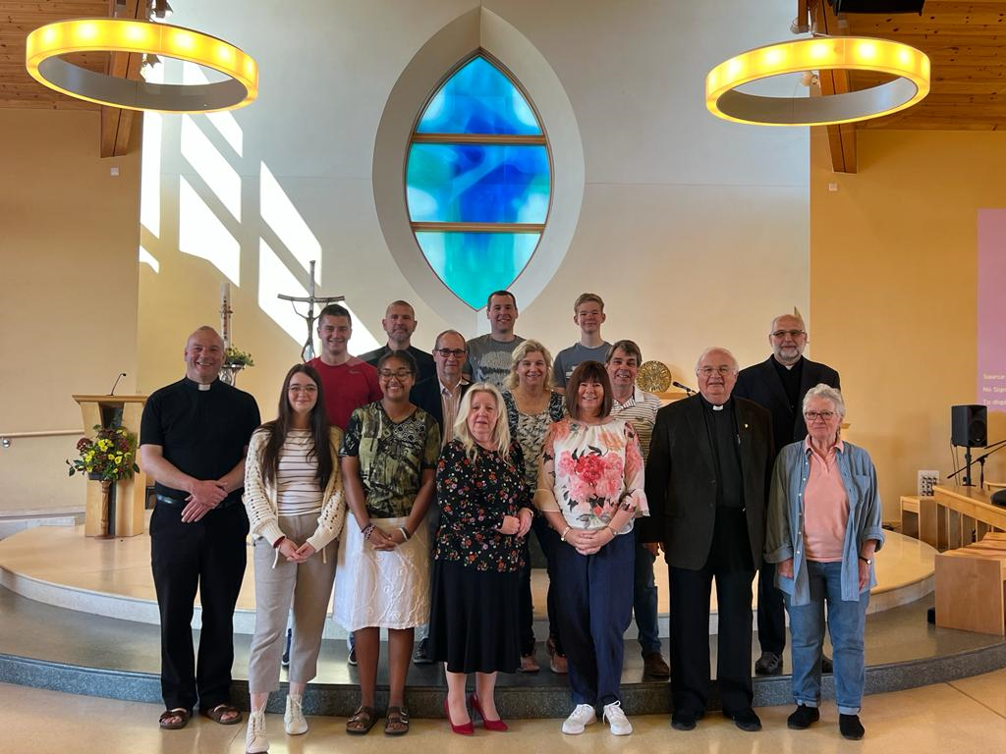
Havant Pastoral Area - Council Members

Slide 14
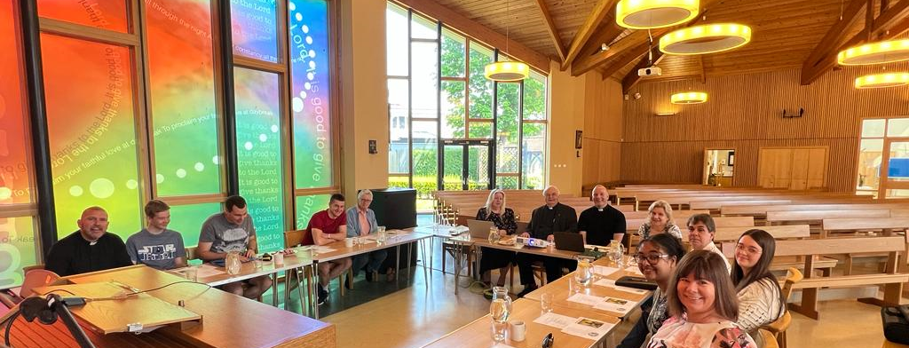
Havant Pastoral Area - Council Members

Slide 15
Fruitfulness of working together and sharing best practice.
Priests covering for each other in times of need.
Alpha and a shared strategy for Evangelisation.
Station Masses
Hospital

Slide 16
Fruitfulness of working together and sharing best practice.
Visiting the Sick and Housebound
Cafod Pastoral Area Walk
Administrators working together
Pilgrimages as a Pastoral Area

Slide 17
3 Pillars Meeting February 2024
Havant, Leigh Park and Waterlooville
Over 100 Parishioners attended these meetings.
Feedback collated from these meetings and examined by the Pastoral Area Council (See Sheets)

Slide 18
Key Themes from the 3 Pillars Meetings
- How do we get more children and youth involvement in our Parish Communities?
Developing the numbers of small groups
Transparency with Finances
Greater Communication around the Pastoral Area

Slide 19
Phase 2 - Havant Pastoral Area Council
 | Christ Centred Church | Missionary Communities | Prudent Stewardship | Chair
Clergy | Fr Jeremy Garratt | Fr James | Canon Gerard | Karena Fulford
Laity | Fr Andrew (SC and SP) Jim Hordell (SH) Viv McCabe (ST) Damian Banka (SJ) Chris Bates (LP) | Gabriel Semple (SH) Jess Semple (SH) James Ryan (SE) Maria Ryan (SE) Michael Rutowski (SJ) Chidi Iheanacho (SH) Josie Higson (HI) David Godwin (Oaklands) Jim George (SH) Ash Jose (SH) Sheila Muesco (SP) | Angela Muxworthy (SJ) Yvonne Hands (SE) Ian Castle (SJ) Noel Hogg (SP)
Chair | Declan Murphy (SE) | Marijke Miles (HI) | Seamus Higson (HI) | Ellen Mcarthy (Secretary)

Slide 20
Youth Development
Commencement of two new groups for young people and young adults.
These meet monthly and have a new lay team supporting these from around our schools and parishes.

Slide 21
Small Groups around the Pastoral Area
Rosary Group at Sacred Heart
Monthly Married Couples and families monthly gathering
New Youth Group
New Young Adults Group
Union of Catholic Mothers
Woman’s Groups
Study Groups

Slide 22
Small Groups
Knit and Natter Group
Bible Study Group
Q and A monthly group
Lectio Divina for Sunday’s Readings
Table Tennis
Justice and Peace Groups
Mother and Toddler Groups
Plans for the Future……

Slide 23
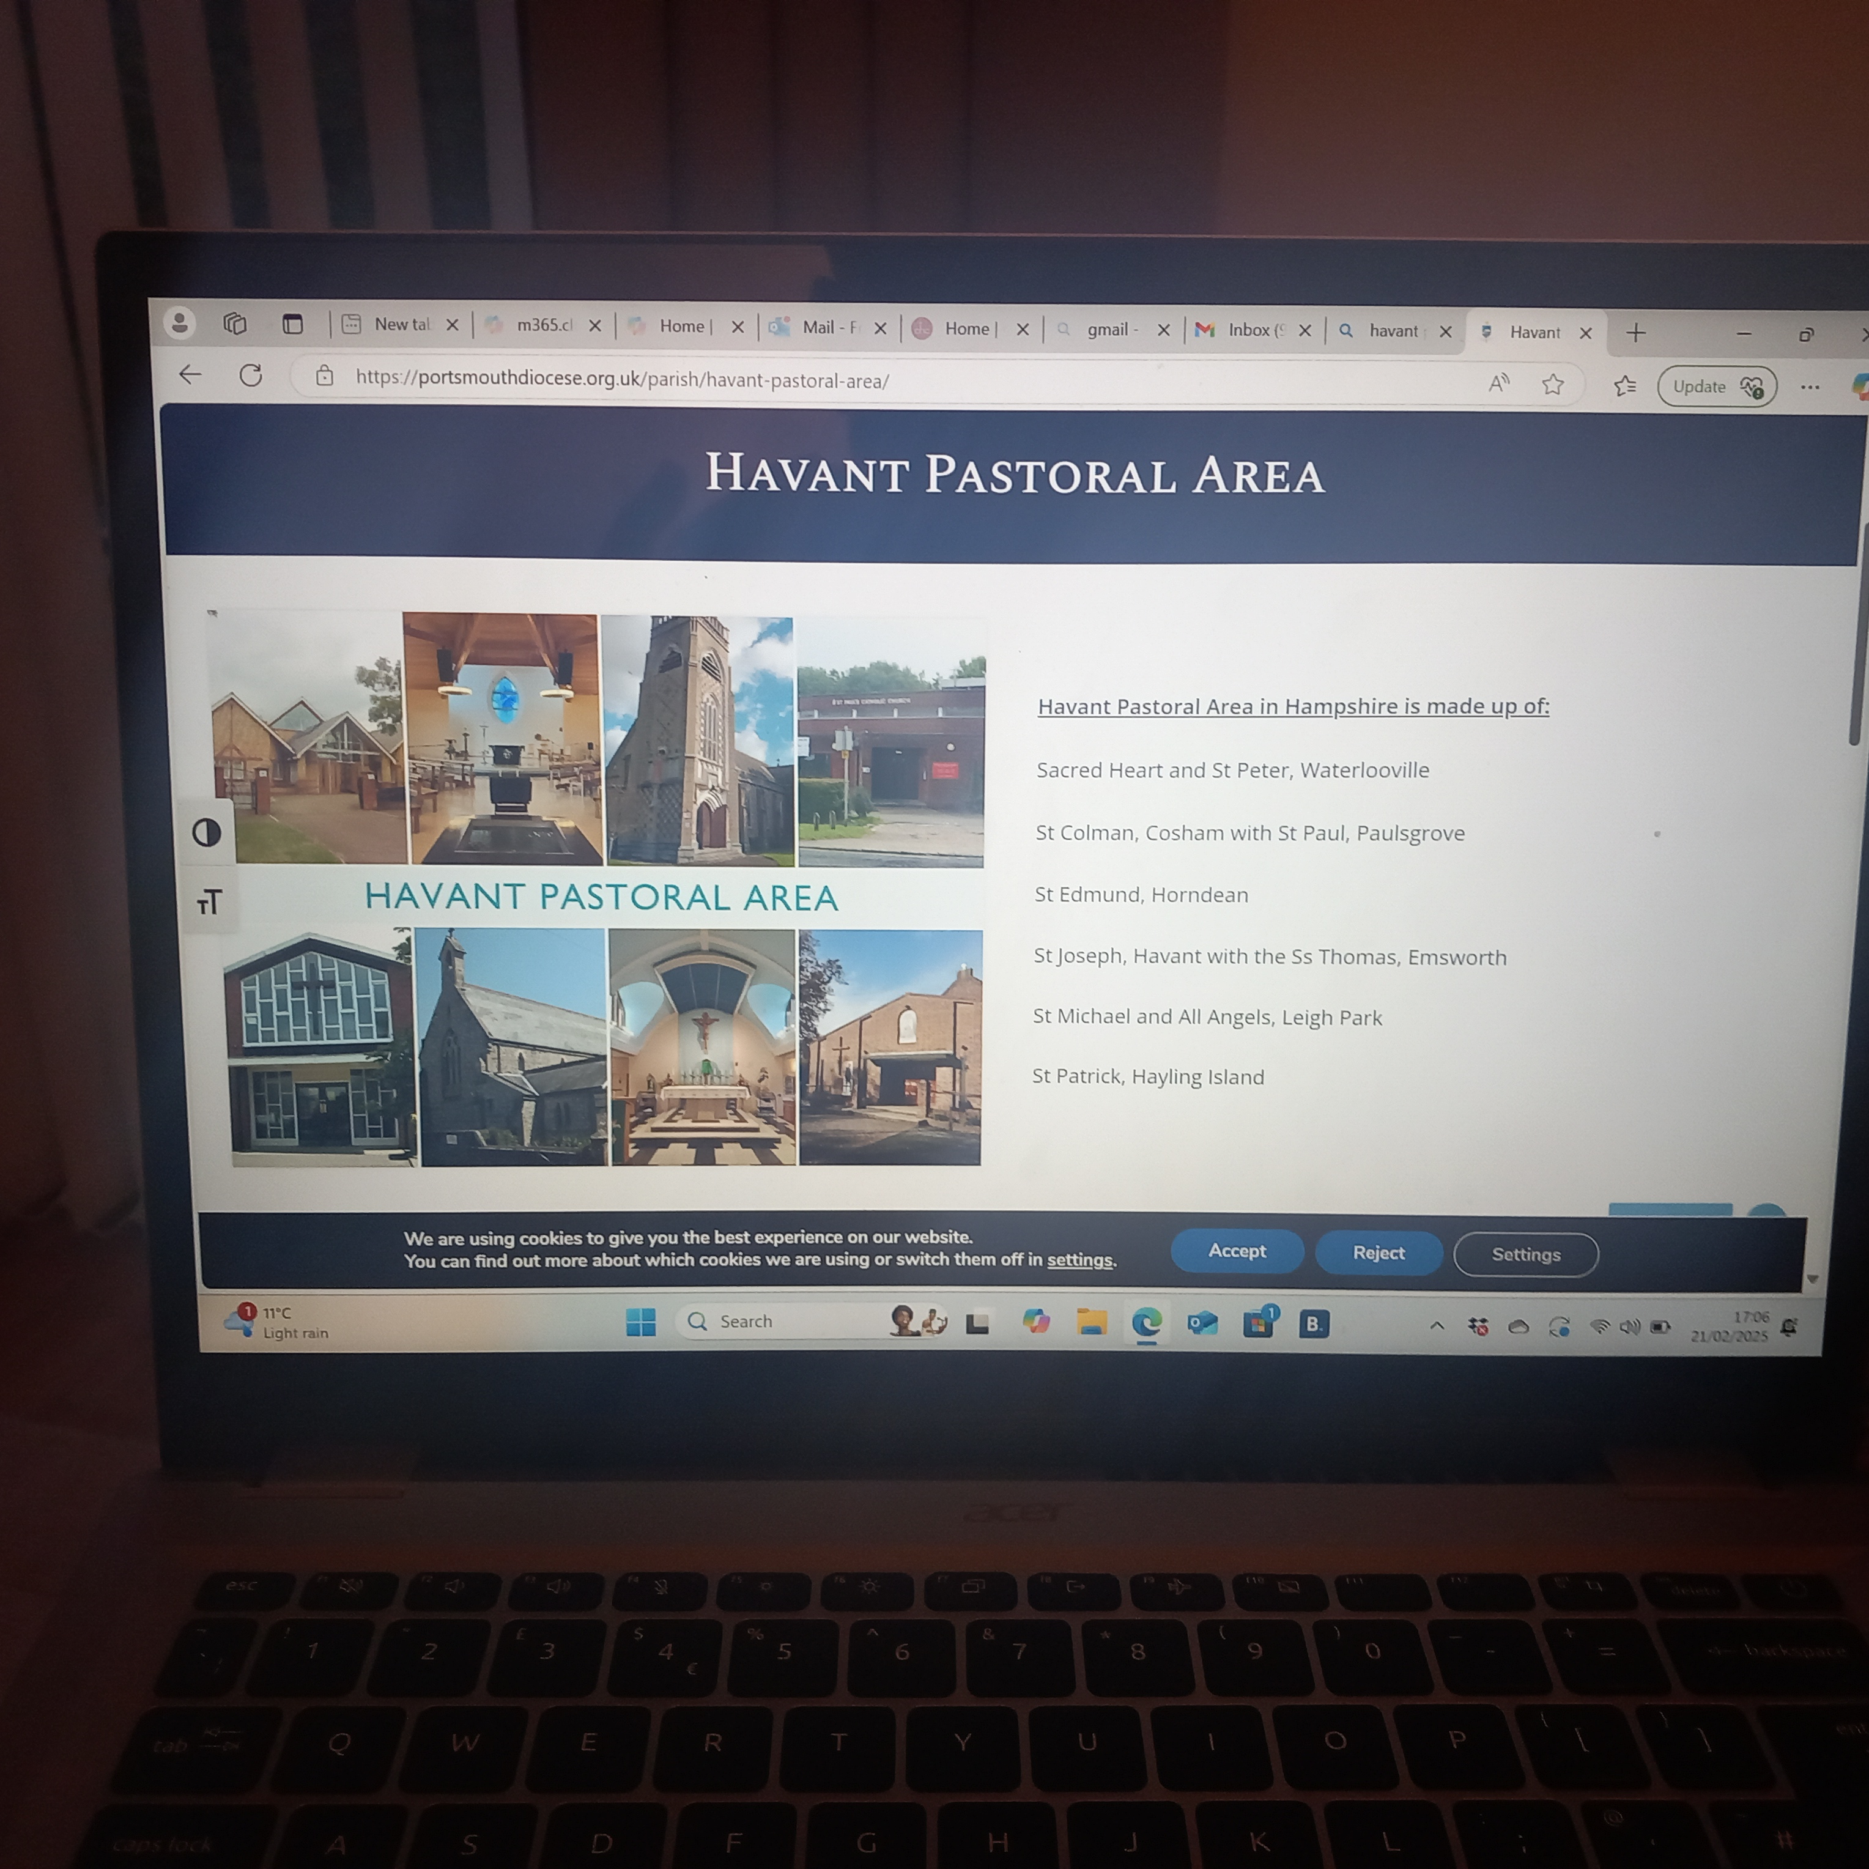
Shared Website for Mass Times and Events around our Parish
Havant Pastoral Area - Catholic Diocese of Portsmouth

Slide 24
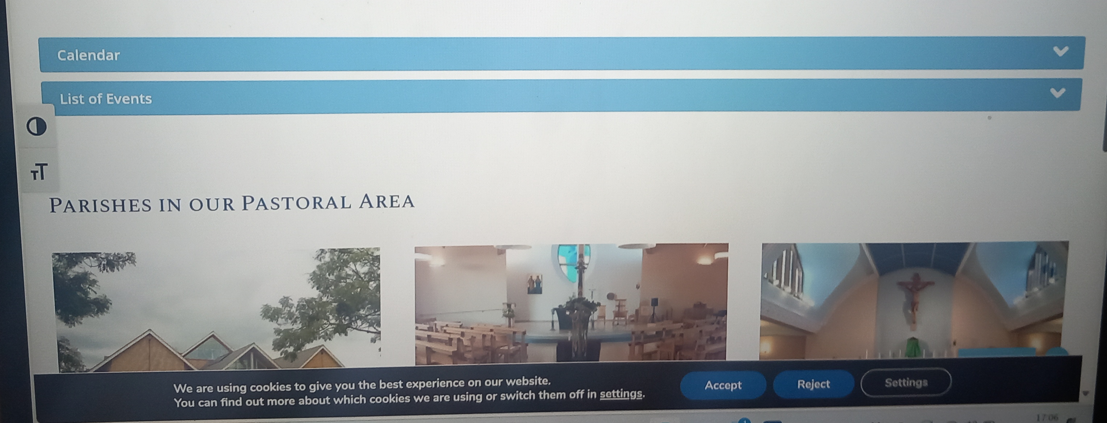
Shared Website for Mass Times and Events Around the Parish

Slide 25
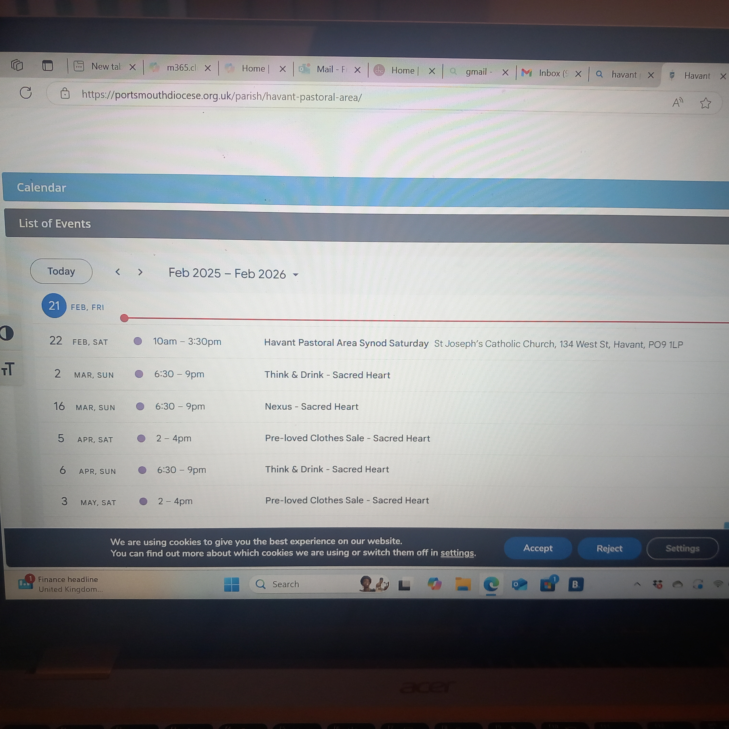
Shared Website for Mass Times and Events Around the Parish

Slide 26
Shared Ongoing Formation opportunities
Readers Training
Eucharistic Ministers Training
Visiting the Sick Training

Slide 27
Alpha Update
10 Alpha courses have been delivered around our Pastoral Area and Online: (Leigh Park, Waterlooville, Horndean, Confirmation, Hayling Island)
160 Guests have attended these with over 30 helpers loving the guests and accompanying the guests on their journey.

Slide 28
Alpha Update
Lives have been transformed. People have encountered Jesus Christ, surrendered their lives to the Lord and chosen to become more committed to the Church and serving in ministries.
Leadership Pipeline Developing – Guests from alpha then joining the team as helpers. Previous leaders in Alpha making way for guests to come onto the alpha team and beginning new groups in our churches connected with our vision.
New Alpha Courses taking place in the Spring for at St Colman's and Oaklands School specifically for Staff.

Slide 29
Havant Pastoral Area Evangelisation and Alpha Structure - Moving Forward
Prospective Guests
Guests
Volunteers / Helpers
Parish Evangelisation Leads x 2 in each of 8 church communities
X 2 Schools Leads
X 2 Hospital Leads
Pastoral Coordinator for Evangelisation
(presently vacant)
Lead Evangelisation
(Fr James)
Pastoral Area Lead
(Fr Jeremy)

Slide 30
Finances and Accountability
Clergy and Pastoral Area Prudent Stewardship Team meetings with Clive Field (Finance Director of the Diocese)
Meeting with all Finance Teams from all Parishes next month
New Software now being used in the Diocese to enable greater transparency of accounts.
Development of Budgets and 5-year plans for Parishes

Slide 31

Jubilee Year of Hope and Station Masses
Lenten Book for the Pastoral Area
Themed Homilies
Opportunities for Minisitry and healing Palm Sunday Weekend

Slide 32

23rd – 27th June

Slide 33

Justice and Peace

Slide 34

Vision for the Future

Slide 35
Vision for the Future
Christ at the centre of our Parish and our lives.
Active Evangelisation taking place in every community
Children and Youth involved in all aspects of Parish life
100s of new Christians being received into our communites every year.

Slide 36
Vision for the Future
Packed Churches with Vibrant Liturgies
A welcome ministry that welcomes all, particularly the marginalized.
Every parishioner is a member of a small group where they are known, loved and grow in their faith.
Youth programmes for every age group from toddler - 35

Slide 37
Vision for the Future
Parishes and Schools working closely together.
Lay Leads for Youth, Catechesis, Evangelisation, Fundraising and Outreach
An Operation Manager supported by a team of administrators in each church community
Healthy Finances in place to enable our vision to be fulfilled.

Slide 38
Vision for the Future
Holy and Inspiring Priests
Excellent Homilies
Ongoing Formation for all
Adoration in our Churches
Over 200 people attending weekday Masses both during the day and Evening / Early Morning.
Outreach projects supporting our local communities particularly the most vulnerable.

